Slide 1



as a hypothetical bacterial immune system
DGR
Sokolov Arseny FS11-63B

Slide 2

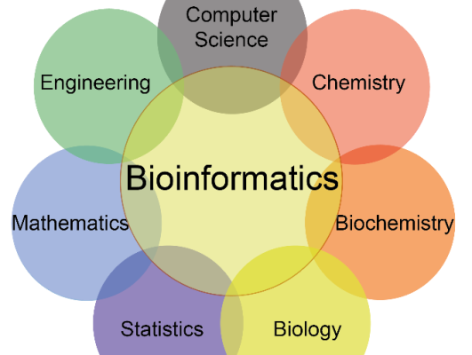
Bioinformatics

Slide 3
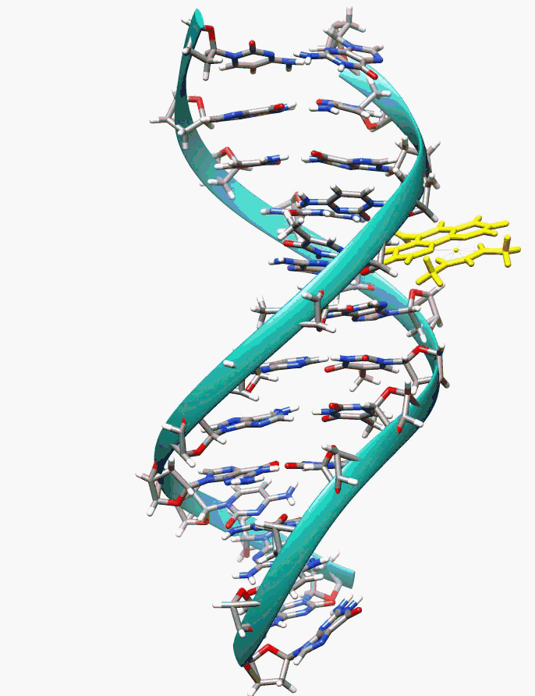
What is DNA?

Slide 4
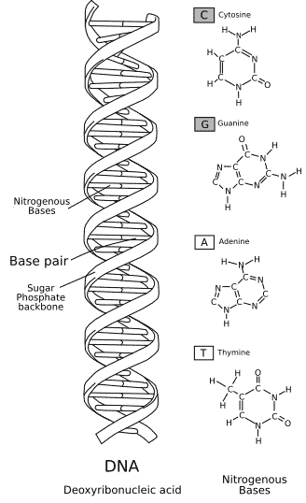
What is DNA?

Slide 5
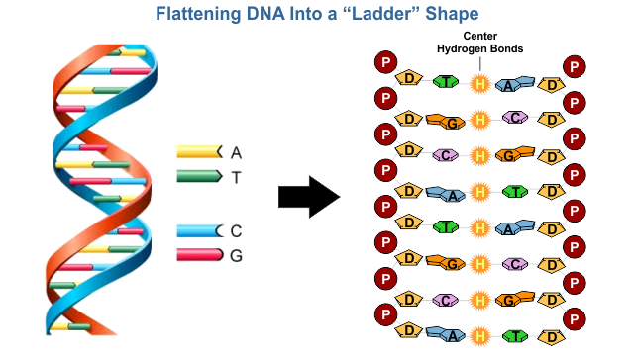
What is DNA?

Slide 6
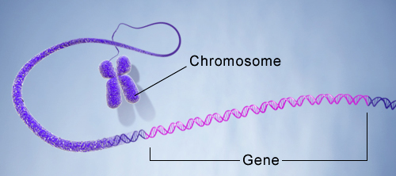
What is DNA?

Slide 7
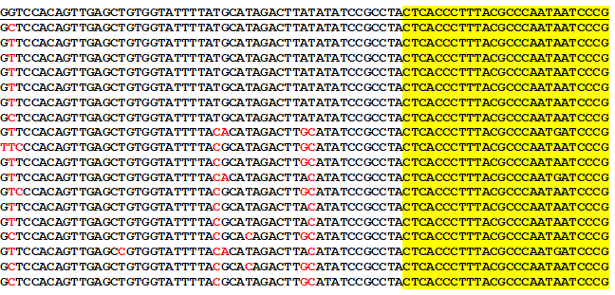
What is DNA?

Slide 8

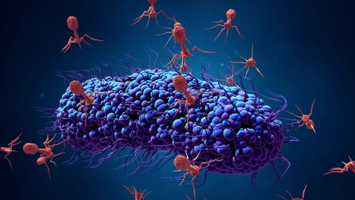
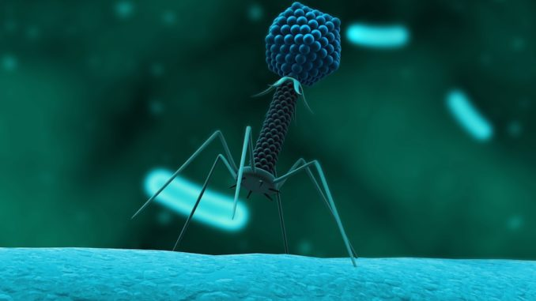

Slide 9

INTRODUCTION
Operons — arrays of co-expressed and coregulated genes

Slide 10
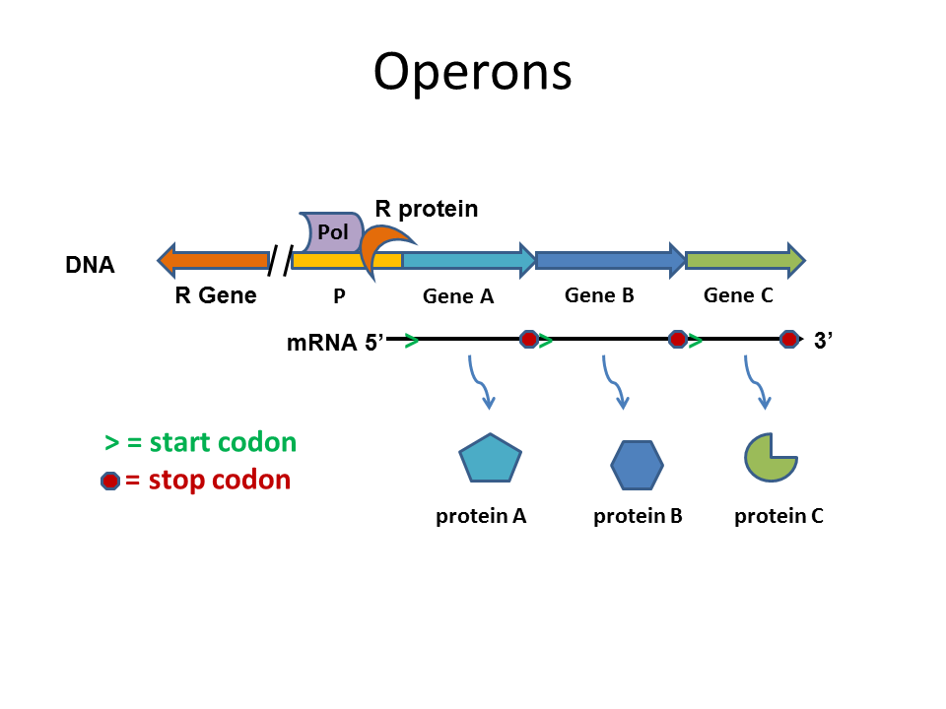
INTRODUCTION
Operons — arrays of co-expressed and coregulated genes

Slide 11
INTRODUCTION
Operons — arrays of co-expressed and coregulated genes
ICITY — protocol to systematic prediction of functionally linked genes in bacterial and archaeal genomes

Slide 12
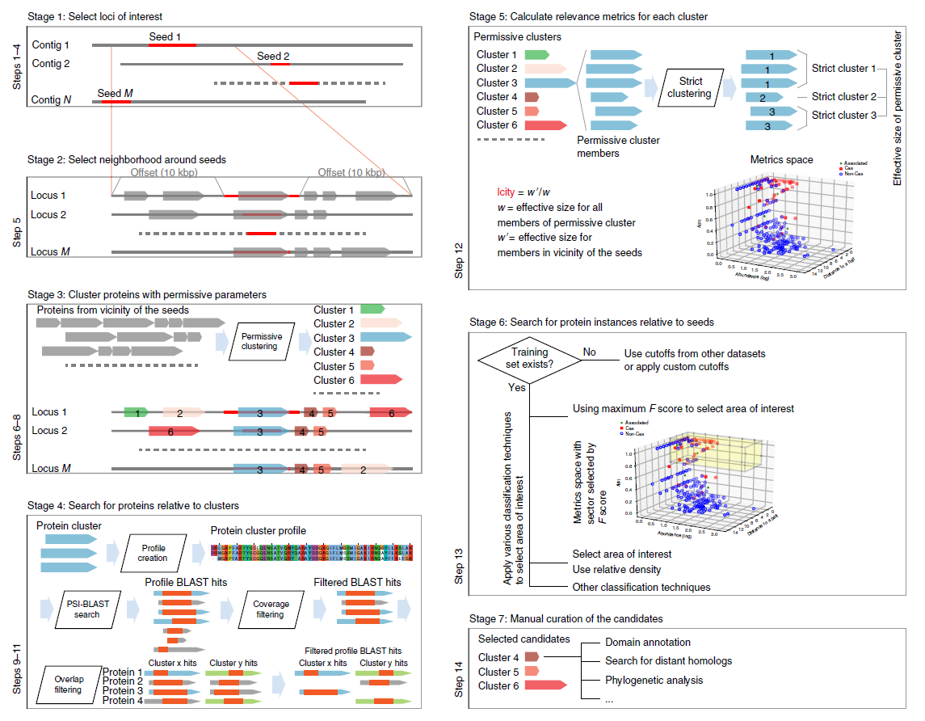
INTRODUCTION
Operons — arrays of co-expressed and coregulated genes
ICITY — protocol to systematic prediction of functionally linked genes in bacterial and archaeal genomes

Slide 13
INTRODUCTION
Operons — arrays of co-expressed and coregulated genes
ICITY — protocol to systematic prediction of functionally linked genes in bacterial and archaeal genomes
DGR —recently discovered operons

Slide 14
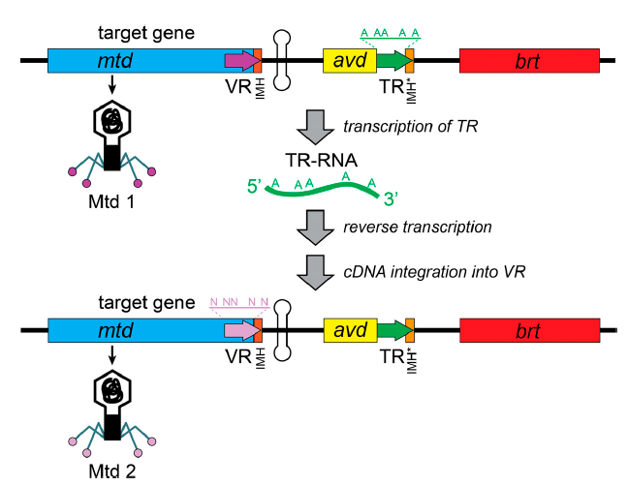
INTRODUCTION
Operons — arrays of co-expressed and coregulated genes
ICITY — protocol to systematic prediction of functionally linked genes in bacterial and archaeal genomes
DGR —recently discovered operons

Slide 15

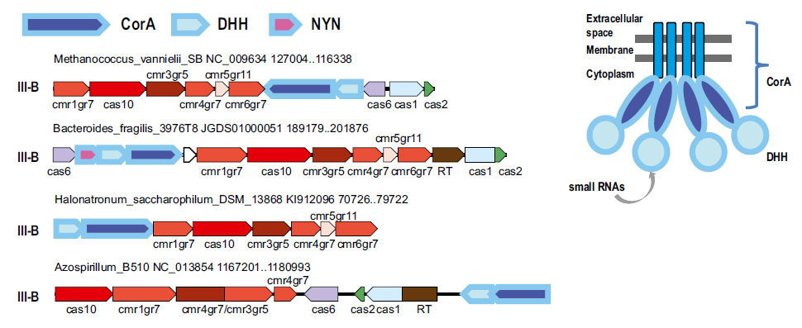
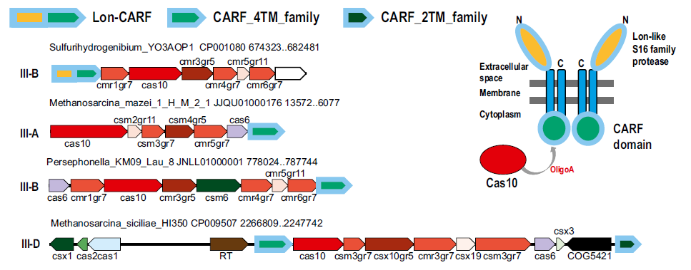
Our results

Slide 16
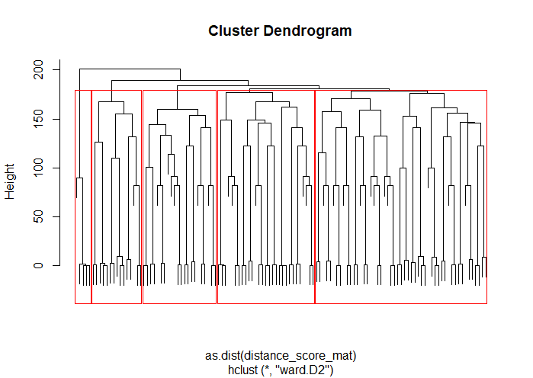
Our results

